Slide 1

Computing Algorithms Lecture 4: Brute force part 1
By: Dr. Mohamed Moheeb

Slide 2
Agenda
Introduction
Selection and Bubble sort
Sequential search and brute-force string matching

Slide 3

Introduction

Slide 4
What is a Brute force strategy
Brute force is a straightforward approach to solving a problem, usually directly based on the problem statement and definitions of the concepts involved.
The algorithm tries all possible solutions until it finds the correct one.
It is based directly on the problem’s definition, without using optimization, heuristics, or shortcuts

Slide 5
Key Characteristics of Brute-Force Algorithms
Simple to design — they follow directly from the problem statement.
Exhaustive — check every candidate solution.
Guaranteed correctness — if a solution exists, brute force will find it.
Often inefficient — can be slow for large input sizes because the number of possibilities grows quickly.

Slide 6
Examples
Password cracking: Trying every possible combination until the correct password is found.
Searching: Linear search checks each element of a list until the target is found.
Combinatorial problems: Generating all permutations or subsets to find an optimal one (e.g., traveling salesman problem).

Slide 7
When Brute Force Is Useful
When the input size is small.
When no faster algorithm is known.
As a simple baseline to compare more advanced algorithms.

Slide 8

Selection and Bubble sort

Slide 9
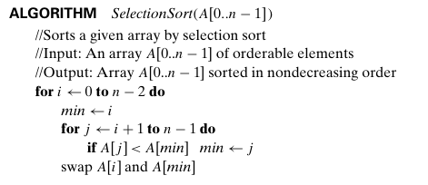
Selection sort
i
0 | 1 | 2 | 3 | 4
14 | 21 | 1 | 12 | 14
Let’s trace the selection sort on this given array of size n=5
First the for loop i=0 till it reach n-2 or in this case 3
Variables
i=0

Slide 10
Selection sort
i, min
0 | 1 | 2 | 3 | 4
14 | 21 | 1 | 12 | 14
min is assigned the value of i=0
Variables
i=0
min=0

Slide 11
Selection sort
i, min
j
0 | 1 | 2 | 3 | 4
14 | 21 | 1 | 12 | 14
Starting the inner loop where j will start from j=i+1 or j=0+1=1 till it reaches n-1 or 4
Variables
i=0
min=0
j=1

Slide 12
Selection sort
i, min
j
0 | 1 | 2 | 3 | 4
14 | 21 | 1 | 12 | 14
Check the condition for A[j] < A[min] or A[1]< A[0] = 21<14 which is false
Variables
i=0
min=0
j=1

Slide 13
Selection sort
i, min
j
0 | 1 | 2 | 3 | 4
14 | 21 | 1 | 12 | 14
We go back to the inner loop and increment the variable j by 1 where j =2, which still didn’t reach more than n-1 or 4
Variables
i=0
min=0
j=2

Slide 14
Selection sort
i
j,min
0 | 1 | 2 | 3 | 4
14 | 21 | 1 | 12 | 14
Check the condition for A[j] < A[min] or A[2]< A[0] = 1<14, which is true, then we change the min value to 2
Variables
i=0
min=2
j=2

Slide 15
Selection sort
i
min
j
0 | 1 | 2 | 3 | 4
14 | 21 | 1 | 12 | 14
We go back to the inner loop and increment the variable j by 1, where j =3, which still didn’t reach more than n-1 or 4
Variables
i=0
min=2
j=3

Slide 16
Selection sort
i
min
j
0 | 1 | 2 | 3 | 4
14 | 21 | 1 | 12 | 14
Check the condition for A[j] < A[min] or A[3]< A[2] = 12<1 which is false
Variables
i=0
min=2
j=3

Slide 17
Selection sort
i
min
j
0 | 1 | 2 | 3 | 4
14 | 21 | 1 | 12 | 14
We go back to the inner loop and increment the variable j by 1, where j =4, which still didn’t reach more than n-1 or 4
Variables
i=0
min=2
j=4

Slide 18
Selection sort
i
min
j
0 | 1 | 2 | 3 | 4
14 | 21 | 1 | 12 | 14
Check the condition for A[j] < A[min] or A[4]< A[2] = 14<1 which is false
Variables
i=0
min=2
j=4

Slide 19
Selection sort
i
min
j
0 | 1 | 2 | 3 | 4
14 | 21 | 1 | 12 | 14
We go back to the inner loop and increment the variable j by 1, where j =5, which reached more than n-1 or 4
Variables
i=0
min=2
j=5

Slide 20
Selection sort
i
min
j
0 | 1 | 2 | 3 | 4
14 | 21 | 1 | 12 | 14
1
14
The innermost loop is finished now we move to swap A[i] and A[min] which will swap A[0] and A[2] or 14 with 1
Variables
i=0
min=2
j=5

Slide 21
Selection sort
i
0 | 1 | 2 | 3 | 4
1 | 21 | 14 | 12 | 14
The outer loop increases i by 1, it will be equal to 1, and still didn’t reach more than n-2 or 3
Variables
i=1
min=2
j=5

Slide 22
Selection sort
i, min
0 | 1 | 2 | 3 | 4
1 | 21 | 14 | 12 | 14
min is assigned the value of i=1
Variables
i=1
min=1

Slide 23
Selection sort
i,min
j
0 | 1 | 2 | 3 | 4
1 | 21 | 14 | 12 | 14
The inner loop index j will be reset to i+1 which will be equal to j=2 till it reaches more than n-1 or 4
Variables
i=1
min=1
j=2

Slide 24
Selection sort
i
j,min
0 | 1 | 2 | 3 | 4
1 | 21 | 14 | 12 | 14
Check the condition for A[j] < A[min] or A[2]< A[1] = 14<21, which is true, so the new value of min is 2
Variables
i=1
min=2
j=2

Slide 25
Selection sort
i
min
j
0 | 1 | 2 | 3 | 4
1 | 21 | 14 | 12 | 14
The outer loop increases i by 1, it will be equal to 1, and it still didn’t reach more than n-2 or 3
Variables
i=1
min=2
j=3

Slide 26
Selection sort
i
j,min
0 | 1 | 2 | 3 | 4
1 | 21 | 14 | 12 | 14
Check the condition for A[j] < A[min] or A[3]< A[2] = 12<14, which is true, so the new value of min is 3
Variables
i=1
min=3
j=3

Slide 27
Selection sort
i
min
j
0 | 1 | 2 | 3 | 4
1 | 21 | 14 | 12 | 14
We go back to the inner loop and increment the variable j by 1, where j =4, which didn't reach more than n-1 or 4
Variables
i=1
min=3
j=4

Slide 28
Selection sort
i
min
j
0 | 1 | 2 | 3 | 4
1 | 21 | 14 | 12 | 14
Check the condition for A[j] < A[min] or A[4]< A[3] = 14<12 which is false.
Variables
i=1
min=3
j=4

Slide 29
Selection sort
i
min
j
0 | 1 | 2 | 3 | 4
1 | 21 | 14 | 12 | 14
We go back to the inner loop and increment the variable j by 1, where j =5, which reaches more than n-1 or 4
Variables
i=1
min=3
j=5

Slide 30
Selection sort
i
min
0 | 1 | 2 | 3 | 4
1 | 21 | 14 | 12 | 14
12
21
The innermost loop is finished now we move to swap A[i] and A[min] which will swap A[1] and A[3] or 21 with 12
Variables
i=1
min=3
j=5

Slide 31
Selection sort
i
0 | 1 | 2 | 3 | 4
1 | 12 | 14 | 21 | 14
The outer loop increases i by 1, it will be equal to 2, and it still didn’t reach more than n-2 or 3
Variables
i=2
min=3
j=5

Slide 32
Selection sort
i,min
0 | 1 | 2 | 3 | 4
1 | 12 | 14 | 21 | 14
Reset the value of min is equal to i=2
Variables
i=2
min=2
j=5

Slide 33
Selection sort
i,min
j
0 | 1 | 2 | 3 | 4
1 | 12 | 14 | 21 | 14
We go back to the inner loop and reset the value of j to i+1, equal to 3 till it reaches more than n-1 or 4
Variables
i=2
min=2
j= 3

Slide 34
Selection sort
i,min
j
0 | 1 | 2 | 3 | 4
1 | 12 | 14 | 21 | 14
Check the condition for A[j] < A[min] or A[3]< A[2] = 21<14 which is false.
Variables
i=2
min=2
j=3

Slide 35
Selection sort
i,min
j
0 | 1 | 2 | 3 | 4
1 | 12 | 14 | 21 | 14
We go back to the inner loop and increment the variable j by 1, where j =4, which still didn’t reach more than n-1 or 4
Variables
i=2
min=2
j=4

Slide 36
Selection sort
i,min
j
0 | 1 | 2 | 3 | 4
1 | 12 | 14 | 21 | 14
Check the condition for A[j] < A[min] or A[4]< A[2] = 14<14 which is false.
Variables
i=2
min=2
j=4

Slide 37
Selection sort
i,min
j
0 | 1 | 2 | 3 | 4
1 | 12 | 14 | 21 | 14
We go back to the inner loop and increment the variable j by 1, where j =5, which reached more than n-1 or 4
Variables
i=2
min=2
j=5

Slide 38
Selection sort
i,min
0 | 1 | 2 | 3 | 4
1 | 12 | 14 | 21 | 14
The innermost loop is finished now we move to swap A[i] and A[min] which will swap A[2] and A[2] where no change is required
Variables
i=2
min=2
j=5

Slide 39
Selection sort
i
0 | 1 | 2 | 3 | 4
1 | 12 | 14 | 21 | 14
We go back to the outermost loop, where we reach the final iteration, where i=3 till it reach more than n-2 or 3
Variables
i=3
min=2
j=5

Slide 40
Selection sort
i,min
0 | 1 | 2 | 3 | 4
1 | 12 | 14 | 21 | 14
The min value is reset to be equal to i or 3
Variables
i=3
min=3
j=5

Slide 41
Selection sort
i,min
j
0 | 1 | 2 | 3 | 4
1 | 12 | 14 | 21 | 14
The value for j is reset to be equal to i+1 or 4 till it reaches more than n-1 or 4
Variables
i=3
min=3
j=4

Slide 42
Selection sort
i
j,min
0 | 1 | 2 | 3 | 4
1 | 12 | 14 | 21 | 14
Check the condition for A[j] < A[min] or A[4]< A[3] = 21<14, which is true, so the new value of min is 4.
Variables
i=3
min=4
j=4

Slide 43
Selection sort
i
min
j
0 | 1 | 2 | 3 | 4
1 | 12 | 14 | 21 | 14
The value of j is increased by 1 to be equal to 5 which is more than n-1 or 4
Variables
i=3
min=4
j=5

Slide 44
Selection sort
i
min
0 | 1 | 2 | 3 | 4
1 | 12 | 14 | 21 | 14
14
21
The innermost loop is finished now we move to swap A[i] and A[min] which will swap A[3] and A[4] or 21 with 14.
Variables
i=3
min=4
j=5

Slide 45
Selection sort
i
0 | 1 | 2 | 3 | 4
1 | 12 | 14 | 14 | 21
the value of i is increased by 1, equal to 4, which is more than n-2 or 3, and the outermost loop stops
The array is now sorted
Variables
i=4
min=4
j=5

Slide 46
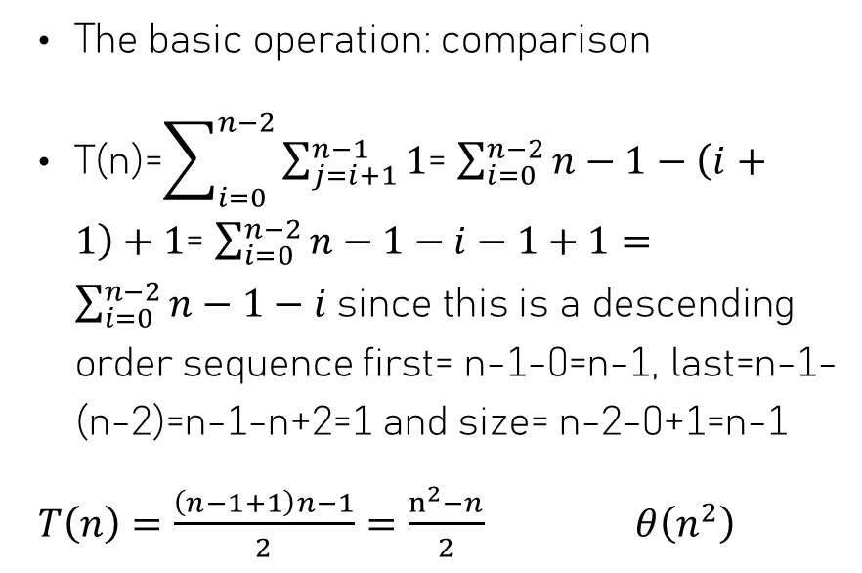
Selection sort (Time analysis)
The basic operation: comparison
T(n)=$\sum_{i=0}^{n−2}{\sum_{j=i+1}^{n−1}{1}}$= $\sum_{i=0}^{n−2}{n−1−\left(i+1\right)+1}$= $\sum_{i=0}^{n−2}{n−1−i−1+1}=$ $\sum_{i=0}^{n−2}{n−1−i}$since this is a descending order sequence first= n-1-0=n-1, last=n-1-(n-2)=n-1-n+2=1 and size= n-2-0+1=n-1
$T\left(n\right)=\frac{\left(n−1+1\right)n−1}{2}=\frac{n^{2}−n}{2}$ $θ\left(n^{2}\right)$
1 basic operation

Slide 47
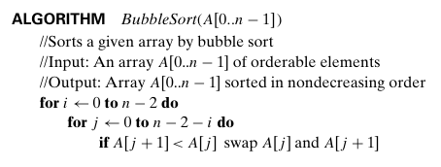
Bubble sort
0 | 1 | 2 | 3 | 4
14 | 21 | 1 | 12 | 14
Now, let’s trace the bubble sort on the same array
Starting from outermost loop where i=0 till it reach more than n-2 or 3
Variables
i=0

Slide 48
Bubble sort
0 | 1 | 2 | 3 | 4
14 | 21 | 1 | 12 | 14
Next, we move to inner loop where j=0 till it reach n-2-i or n-2-0= n-2 or 3.
This algorithm differs from the selection sort as it swaps two adjacent numbers when the lower index is greater in value.
Variables
i=0
j=0

Slide 49
Bubble sort
j
0 | 1 | 2 | 3 | 4
14 | 21 | 1 | 12 | 14
Check if A[j+1]<A[j] which is equal A[1]<A[0] or 21<14 which is false
Variables
i=0
j=0

Slide 50
Bubble sort
j
0 | 1 | 2 | 3 | 4
14 | 21 | 1 | 12 | 14
Increase the value of j by 1 then j =1.till it reaches a value greater than n-2-0 or 5-2-0=3
Variables
i=0
j=1

Slide 51
Bubble sort
j
j+1
0 | 1 | 2 | 3 | 4
14 | 21 | 1 | 12 | 14
1
21
Check if A[j+1]<A[j] which is equal A[2]<A[1] or 1<21 which is true then we swap A[2] with A[1] or 21 and 1
Variables
i=0
j=1

Slide 52
Bubble sort
j
0 | 1 | 2 | 3 | 4
14 | 1 | 21 | 12 | 14
Increase the value of j by 1 then j =2.till it reaches a value greater than n-2-0 or 5-2-0=3
Variables
i=0
j=2

Slide 53
Bubble sort
j
j+1
0 | 1 | 2 | 3 | 4
14 | 1 | 21 | 12 | 14
12
21
Check if A[j+1]<A[j] which is equal A[3]<A[2] or 1<21 which is true then we swap A[3] with A[2] or 21 and 12
Variables
i=0
j=2

Slide 54
Bubble sort
j
0 | 1 | 2 | 3 | 4
14 | 1 | 12 | 21 | 14
Increase the value of j by 1 then j =3.till it reaches a value greater than n-2-0 or 5-2-0=3
Variables
i=0
j=3

Slide 55
Bubble sort
j
j+1
0 | 1 | 2 | 3 | 4
14 | 1 | 12 | 21 | 14
14
21
Check if A[j+1]<A[j] which is equal A[4]<A[3] or 1<21 which is true then we swap A[4] with A[3] or 14 and 21
Variables
i=0
j=3

Slide 56
Bubble sort
0 | 1 | 2 | 3 | 4
14 | 1 | 12 | 14 | 21
Increase the value of j by 1 then j =4.which is more than n-2-0 or 5-2-0=3.
Variables
i=0
j=4

Slide 57
Bubble sort
0 | 1 | 2 | 3 | 4
14 | 1 | 12 | 14 | 21
We go back to the outer loop and increase the value of i by 1, which will be equal to 1 till it reaches more than n-2 or 3.
Variables
i=1

Slide 58
Bubble sort
j
0 | 1 | 2 | 3 | 4
14 | 1 | 12 | 14 | 21
In the inner loop, j will start from 0 till it till it reaches a value greater than n-2-i or 5-2-1=2
Variables
i=1
j=0

Slide 59
Bubble sort
j
j+1
0 | 1 | 2 | 3 | 4
14 | 1 | 12 | 14 | 21
1
14
Check if A[j+1]<A[j] which is equal A[1]<A[0] or 1<14 which is true then we swap A[1] with A[0] or 14 and 1
Variables
i=1
j=0

Slide 60
Bubble sort
j
0 | 1 | 2 | 3 | 4
1 | 14 | 12 | 14 | 21
Increase the value of j by 1 then j =1.which is less than n-2-i or 5-2-1=2.
Variables
i=1
j=1

Slide 61
Bubble sort
j
j+1
0 | 1 | 2 | 3 | 4
1 | 14 | 12 | 14 | 21
12
14
Check if A[j+1]<A[j] which is equal A[2]<A[1] or 12<14 which is true then we swap A[2] with A[1] or 12 and 14
Variables
i=1
j=1

Slide 62
Bubble sort
j
0 | 1 | 2 | 3 | 4
1 | 12 | 14 | 14 | 21
Increase the value of j by 1 then j =2.which is equal to n-2-0 or 5-2-1=2.
Variables
i=1
j=2

Slide 63
Bubble sort
j
j+1
0 | 1 | 2 | 3 | 4
1 | 12 | 14 | 14 | 21
Check if A[j+1]<A[j] which is equal A[3]<A[2] or 14<14 which is false, so no swap is going to be performed
Variables
i=1
j=2

Slide 64
Bubble sort
j
0 | 1 | 2 | 3 | 4
1 | 12 | 14 | 14 | 21
Increase the value of j by 1 then j =3.which is more than n-2-i or 5-2-1=2.
Variables
i=1
j=3

Slide 65
Bubble sort
0 | 1 | 2 | 3 | 4
1 | 12 | 14 | 14 | 21
We go back to the outer loop and increase the value of i by 1, which will be equal to 2 till it is greater than n-2 or 3.
Variables
i=2

Slide 66
Bubble sort
j
0 | 1 | 2 | 3 | 4
1 | 12 | 14 | 14 | 21
In the inner loop, j will start from 0 till it till it reaches a value greater than n-2-i or 5-2-2=1
.
Variables
i=2
j=0

Slide 67
Bubble sort
j
j+1
0 | 1 | 2 | 3 | 4
1 | 12 | 14 | 14 | 21
Check if A[j+1]<A[j], which is equal A[1]<A[0] or 12<1 which is false, so no swap is going to be performed
Variables
i=2
j=2

Slide 68
Bubble sort
j
0 | 1 | 2 | 3 | 4
1 | 12 | 14 | 14 | 21
Increase the value of j by 1 then j =1.which is equal to n-2-i or 5-2-2=1.
Variables
i=2
j=1

Slide 69
Bubble sort
j
j+1
0 | 1 | 2 | 3 | 4
1 | 12 | 14 | 14 | 21
Check if A[j+1]<A[j], which is equal A[2]<A[1] or 14<12 which is false, so no swap is going to be performed
Variables
i=2
j=1

Slide 70
Bubble sort
j
0 | 1 | 2 | 3 | 4
1 | 12 | 14 | 14 | 21
Increase the value of j by 1 then j =2.which is more than n-2-i or 5-2-2=1.
Variables
i=2
j=2

Slide 71
Bubble sort
0 | 1 | 2 | 3 | 4
1 | 12 | 14 | 14 | 21
We go back to the outer loop and increase the value of i by 1, which will be equal to 3 till it is greater than n-2 or 3.
Variables
i=3

Slide 72
Bubble sort
j
0 | 1 | 2 | 3 | 4
1 | 12 | 14 | 14 | 21
In the inner loop, j will start from 0 till it till it reaches a value greater than or equal to n-2-i or 5-2-3=0
.
Variables
i=3
j=0

Slide 73
Bubble sort
j
j+1
0 | 1 | 2 | 3 | 4
1 | 12 | 14 | 14 | 21
Check if A[j+1]<A[j], which is equal A[1]<A[0] or 12<1 which is false, so no swap needed
Variables
i=3
j=0

Slide 74
Bubble sort
j
0 | 1 | 2 | 3 | 4
1 | 12 | 14 | 14 | 21
The value j is increased by 1, where j=1, which is more than n-2-i or 5-2-3=0.
.
Variables
i=3
j=0

Slide 75
Bubble sort
0 | 1 | 2 | 3 | 4
1 | 12 | 14 | 14 | 21
We go back to the outer loop and increase the value of i by 1, which will be equal to 4 till it reaches more than n-2 or 3.
The outer loop stops
The array is sorted
Variables
i=4

Slide 76
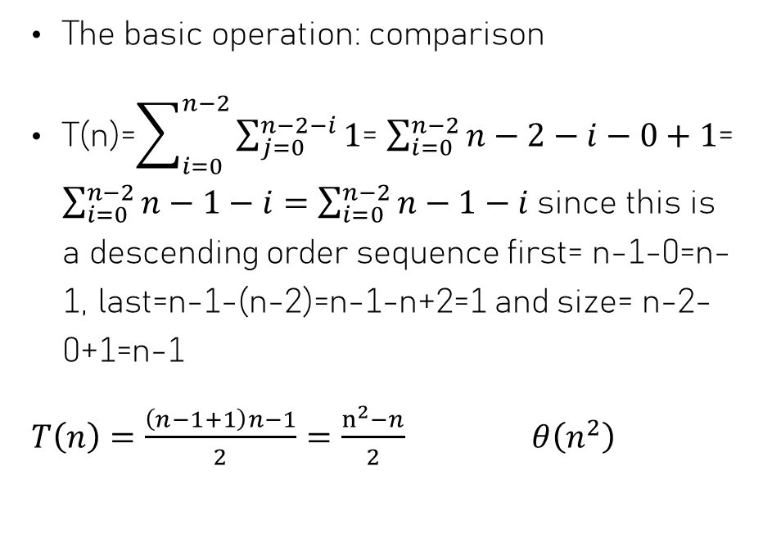
Bubble sort (time analysis)
The basic operation: comparison
T(n)=$\sum_{i=0}^{n−2}{\sum_{j=0}^{n−2−i}{1}}$= $\sum_{i=0}^{n−2}{n−2−i−0+1}$= $\sum_{i=0}^{n−2}{n−1−i}=$ $\sum_{i=0}^{n−2}{n−1−i}$since this is a descending order sequence first= n-1-0=n-1, last=n-1-(n-2)=n-1-n+2=1 and size= n-2-0+1=n-1
$T\left(n\right)=\frac{\left(n−1+1\right)n−1}{2}=\frac{n^{2}−n}{2}$ $θ\left(n^{2}\right)$
1 basic operation

Slide 77

Sequential search and String matching

Slide 78
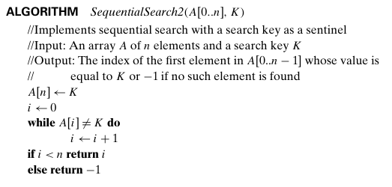
Sequential Search
0 | 1 | 2 | 3 | 4
1 | 16 | 6 | 56 | 12
0 | 1 | 2 | 3 | 4 | 5
1 | 16 | 6 | 56 | 12 | 6
Given that the key we are looking for is equal to 6 in the given array
The first step is to append the key to the end of the list
Variables
k=6

Slide 79
Sequential Search
i
0 | 1 | 2 | 3 | 4 | 5
1 | 16 | 6 | 56 | 12 | 6
Create an index i which starts from 0
Variables
k=6
i=0

Slide 80
Sequential Search
i
0 | 1 | 2 | 3 | 4 | 5
1 | 16 | 6 | 56 | 12 | 6
Check if the value of A[i]=A[0]=1 is not equal to k; which is true
Variables
k=6
i=0

Slide 81
Sequential Search
i
0 | 1 | 2 | 3 | 4 | 5
1 | 16 | 6 | 56 | 12 | 6
Increment the value of i by 1, it will be equal 1
Variables
k=6
i=1

Slide 82
Sequential Search
i
0 | 1 | 2 | 3 | 4 | 5
1 | 16 | 6 | 56 | 12 | 6
Check if the value of A[i]=A[1]=16 is not equal to k=6; which is true
Variables
k=6
i=1

Slide 83
Sequential Search
i
0 | 1 | 2 | 3 | 4 | 5
1 | 16 | 6 | 56 | 12 | 6
Increment the value of i by 1, it will be equal 2
Variables
k=6
i=2

Slide 84
Sequential Search
i
0 | 1 | 2 | 3 | 4 | 5
1 | 16 | 6 | 56 | 12 | 6
Check if the value of A[i]=A[2]=6 is not equal to k=6; which is false, and that we found the key.
Variables
k=6
i=2

Slide 85
Sequential Search
i
0 | 1 | 2 | 3 | 4 | 5
1 | 16 | 6 | 56 | 12 | 6
Then we move to the if condition that checks if i is less than n. Since this is true, it returns the index i=2 where the key 6 is found.
Variables
k=6
i=2

Slide 86
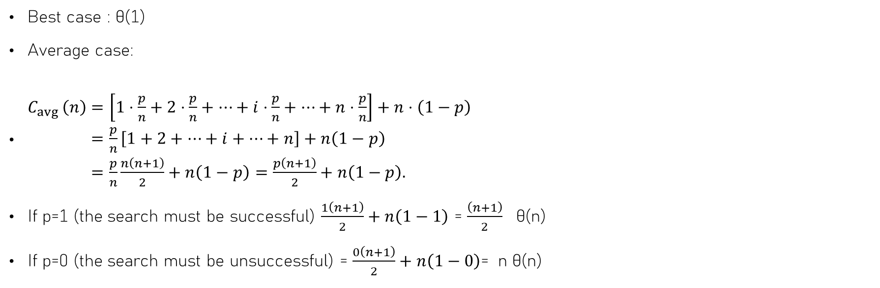
Sequential search (time analysis)
Best case : θ(1)
Average case:
$\begin{aligned}&C_{avg }\left(n\right)&&=\left[1⋅\frac{p}{n}+2⋅\frac{p}{n}+⋯+i⋅\frac{p}{n}+⋯+n⋅\frac{p}{n}\right]+n⋅\left(1−p\right) \\ &&&=\frac{p}{n}\left[1+2+⋯+i+⋯+n\right]+n\left(1−p\right) \\ &&&=\frac{p}{n}\frac{n\left(n+1\right)}{2}+n\left(1−p\right)=\frac{p\left(n+1\right)}{2}+n\left(1−p\right).\end{aligned}$
If p=1 (the search must be successful) $\frac{1\left(n+1\right)}{2}+n\left(1−1\right)$ = $\frac{\left(n+1\right)}{2}$ θ(n)
If p=0 (the search must be unsuccessful) = $\frac{0\left(n+1\right)}{2}+n\left(1−0\right)$= n θ(n)

Slide 87
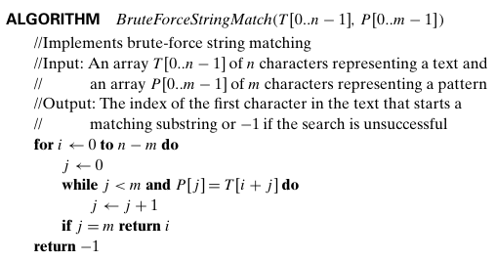
Brute Force String Match
0 | 1
e | r
0 | 1 | 2 | 3 | 4 | 5
b | e | t | t | e | r
T= ‘better’ and p=‘er’
Where n is the length of Text equal 6
m is the length of the pattern, equal 2
The outer loop starts from i=0 till n-m which is 6-2=4
Variables
m=2
n=6
i=0

Slide 88
Brute Force String Match
0 | 1
e | r
0 | 1 | 2 | 3 | 4 | 5
b | e | t | t | e | r
The j is equal to 0.
Variables
m=2
n=6
i=0
j=0

Slide 89
Brute Force String Match
i+j
0 | 1 | 2 | 3 | 4 | 5
b | e | t | t | e | r
j
0 | 1
e | r
Check the condition for the while loop first, j<m 0 < 2. which is true for the second part P[i]=T[i+j] p[0]=T[0+0] or ‘b’=‘e’ which is false.
We skip the while loop
Variables
i=0
j=0
Variables
m=2
n=6
i=0
j=0

Slide 90
Brute Force String Match
i+j
0 | 1 | 2 | 3 | 4 | 5
b | e | t | t | e | r
j
0 | 1
e | r
Check if condition j=m or 0=2 which is false
We go to outer for loop
Variables
i=0
j=0
Variables
m=2
n=6
i=0
j=0

Slide 91
Brute Force String Match
i
0 | 1 | 2 | 3 | 4 | 5
b | e | t | t | e | r
j
0 | 1
e | r
Increment the value of i by 1 till n-m, which is 6-2=4
Variables
m=2
n=6
i=1
j=0

Slide 92
Brute Force String Match
i
0 | 1 | 2 | 3 | 4 | 5
b | e | t | t | e | r
j
0 | 1
e | r
The j is equal to 0.
Variables
m=2
n=6
i=1
j=0

Slide 93
Brute Force String Match
i+j
0 | 1 | 2 | 3 | 4 | 5
b | e | t | t | e | r
j
0 | 1
e | r
Check the condition for the while loop first, j<m 0 < 2. which is true for the second part P[i]=T[i+j] p[0]=T[i+0] or ‘e’=‘e’ which is true.
Variables
i=0
j=0
Variables
m=2
n=6
i=1
j=0

Slide 94
Brute Force String Match
i
0 | 1 | 2 | 3 | 4 | 5
b | e | t | t | e | r
j
0 | 1
e | r
Increment the j value by 1
Variables
i=0
j=0
Variables
m=2
n=6
i=1
j=1

Slide 95
Brute Force String Match
i
i+j
0 | 1 | 2 | 3 | 4 | 5
b | e | t | t | e | r
j
0 | 1
e | r
Check the condition for the while loop first, j<m 0 < 2. which is true for the second part P[i]=T[i+j] p[0]=T[1+1] or ‘t’=‘r’ which is false.
we exit the for loop
Variables
i=0
j=0
Variables
m=2
n=6
i=1
j=1

Slide 96
Brute Force String Match
i
i+j
0 | 1 | 2 | 3 | 4 | 5
b | e | t | t | e | r
j
0 | 1
e | r
Check if condition j=m or 1=2 which is false
We go to the outer for-loop
Variables
i=0
j=0
Variables
m=2
n=6
i=1
j=1

Slide 97
Brute Force String Match
i
0 | 1 | 2 | 3 | 4 | 5
b | e | t | t | e | r
j
0 | 1
e | r
Increment the value of i by 1 till n-m, which is 6-2=4
Variables
m=2
n=6
i=2

Slide 98
Brute Force String Match
i
0 | 1 | 2 | 3 | 4 | 5
b | e | t | t | e | r
j
0 | 1
e | r
j is equal to 0.
Variables
m=2
n=6
i=2
j=0

Slide 99
Brute Force String Match
i+j
0 | 1 | 2 | 3 | 4 | 5
b | e | t | t | e | r
j
0 | 1
e | r
Check the condition for the while loop first, j<m 0 < 2. which is true for the second part P[i]=T[i+j] p[0]=T[2+0] or ‘t’=‘e’ which is false.
We exit the for loop
Variables
i=0
j=0
Variables
m=2
n=6
i=2
j=0

Slide 100
Brute Force String Match
i
0 | 1 | 2 | 3 | 4 | 5
b | e | t | t | e | r
j
0 | 1
e | r
Check if condition j=m or 0=2 which is false
We go to outer for loop
Variables
i=0
j=0
Variables
m=2
n=6
i=2
j=0

Slide 101
Brute Force String Match
i
0 | 1 | 2 | 3 | 4 | 5
b | e | t | t | e | r
j
0 | 1
e | r
Increment the value of i by 1 till n-m, which is 6-2=4
Variables
m=2
n=6
i=3

Slide 102
Brute Force String Match
i
0 | 1 | 2 | 3 | 4 | 5
b | e | t | t | e | r
j
0 | 1
e | r
j is equal to 0.
Variables
m=2
n=6
i=3
j=0

Slide 103
Brute Force String Match
i+j
0 | 1 | 2 | 3 | 4 | 5
b | e | t | t | e | r
j
0 | 1
e | r
Check the condition for the while loop first, j<m 0 < 2. which is true for the second part P[i]=T[i+j] p[0]=T[3+0] or ‘t’=‘e’ which is false.
We exit the for loop
Variables
i=0
j=0
Variables
m=2
n=6
i=3
j=0

Slide 104
Brute Force String Match
i
0 | 1 | 2 | 3 | 4 | 5
b | e | t | t | e | r
j
0 | 1
e | r
Check if condition j=m or 0=2 which is false
We go to outer for loop
Variables
i=0
j=0
Variables
m=2
n=6
i=3
j=0

Slide 105
Brute Force String Match
i
0 | 1 | 2 | 3 | 4 | 5
b | e | t | t | e | r
j
0 | 1
e | r
Increment the value of i by 1 till n-m, which is 6-2=4
Variables
m=2
n=6
i=4

Slide 106
Brute Force String Match
i
0 | 1 | 2 | 3 | 4 | 5
b | e | t | t | e | r
j
0 | 1
e | r
j is equal to 0.
Variables
m=2
n=6
i=4
j=0

Slide 107
Brute Force String Match
i+j
0 | 1 | 2 | 3 | 4 | 5
b | e | t | t | e | r
j
0 | 1
e | r
Check the condition for the while loop first, j<m 0 < 2. which is true for the second part P[i]=T[i+j] p[0]=T[4+0] or ‘e’=‘e’ which is true.
We enter the while loop
Variables
i=0
j=0
Variables
m=2
n=6
i=4
j=0

Slide 108
Brute Force String Match
i
0 | 1 | 2 | 3 | 4 | 5
b | e | t | t | e | r
j
0 | 1
e | r
Increment the j value by 1
Variables
i=0
j=0
Variables
m=2
n=6
i=4
j=1

Slide 109
Brute Force String Match
i
i+j
0 | 1 | 2 | 3 | 4 | 5
b | e | t | t | e | r
j
0 | 1
e | r
Check the condition for the while loop first, j<m 1 < 2. which is true for the second part P[i]=T[i+j] p[0]=T[4+1] or ‘r’=‘r’ which is true.
Variables
i=0
j=0
Variables
m=2
n=6
i=4
j=1

Slide 110
Brute Force String Match
i
i+j
0 | 1 | 2 | 3 | 4 | 5
b | e | t | t | e | r
j
0 | 1
e | r
Increment the j value by 1
Variables
i=0
j=0
Variables
m=2
n=6
i=4
j=2

Slide 111
Brute Force String Match
i
i+j
0 | 1 | 2 | 3 | 4 | 5
b | e | t | t | e | r
j
0 | 1
e | r
Check the condition for the while loop first, j<m 2 < 2. which is false and we exit the loop
Variables
i=0
j=0
Variables
m=2
n=6
i=4
j=2

Slide 112
Brute Force String Match
i
0 | 1 | 2 | 3 | 4 | 5
b | e | t | t | e | r
0 | 1
e | r
Check if condition j=m or 2=2 which is ture
So we return the index i = 2
Variables
i=0
j=0
Variables
m=2
n=6
i=4
j=2

Slide 113
Brute Force String Match (Time analysis)
Standard mathematical analysis for this algorithm can be considered impractical because the actual number of basic operations depends entirely on the specific content of the two input parameters (the text and the pattern).
So we can take the probability of matching one character in the English language is 1/26, which is actually very low, so the average case can be approximated as θ(n) or more accurately θ(n+m). n is the number of mismatches, and m is the number of matches of the pattern with the text.
The worst case, which is a rare occurrence, for example, a pattern of ‘aaab’ and text of all a’s (‘aaaaaaa…….’). In this case, it will be almost O(n.m)

